Slide 1




Crop Yield Prediction Using Machine Learning
A data-driven approach to enhance agricultural productivity
Submitted by: Pushkarjay Ajay
Under guidance of: Bhargavesh Dakka
Submitted to: SURE Trust

Slide 2










Agenda
01
02
03
Problem Statement
Objective of the Project
Dataset Overview
04
05
06
Data Preprocessing
Exploratory Data Analysis
ML Models & Performance
07
08
09
Feature Importance
Conclusion & Future Work
Acknowledgements
Using Machine Learning to predict crop yield and support smart agriculture

Slide 3

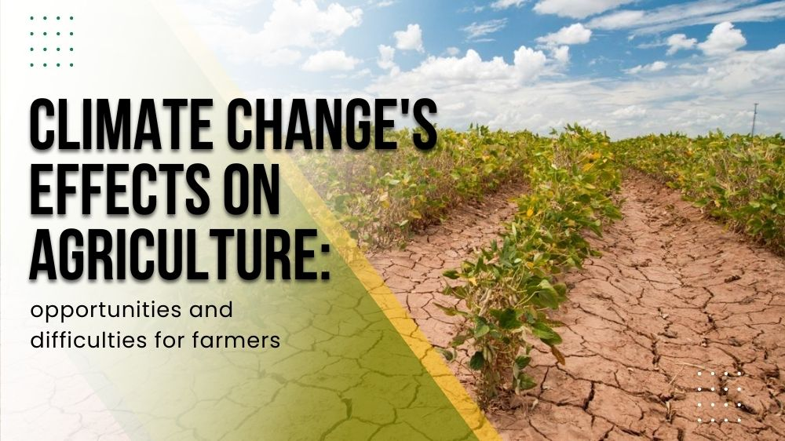


Problem Statement
Why Predict Crop Yield?
Essential for food security, economic planning, and resource optimization
Farmer Challenges
• Climate variability affecting growing conditions
• Soil differences across fields
• Unknown yield causing financial uncertainty
ML Solution
Data-driven predictions using environmental factors to forecast yield with higher accuracy

Slide 4

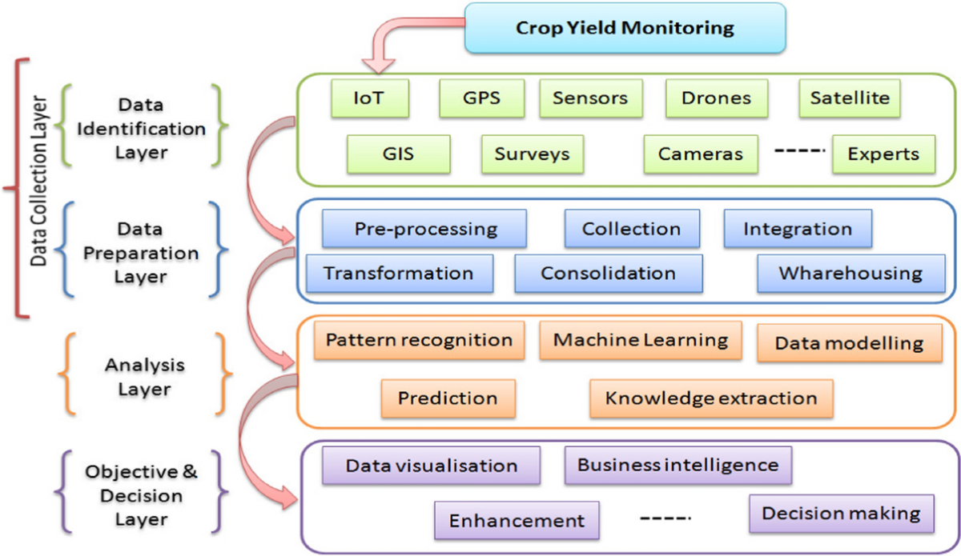


Objective of the Project
Predict Yield
Accurately forecast crop output in Q/acre using historical data
Analyze Conditions
Examine environmental and agricultural factors affecting growth
Identify Key Factors
Determine which variables have the strongest influence on yield
Build ML Model
Create an interpretable model for practical farm use

Slide 5

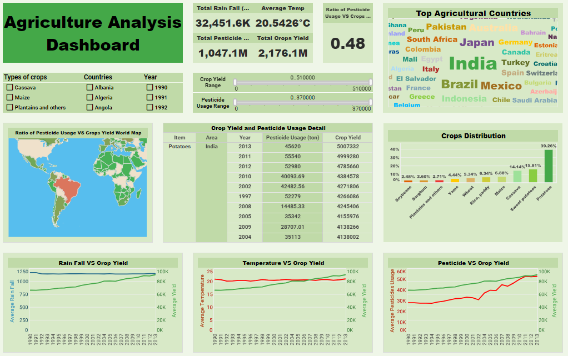
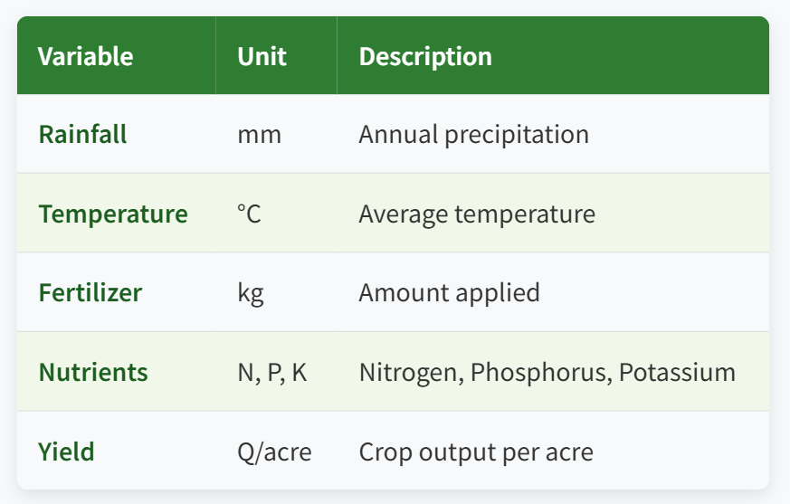
Dataset Overview
Key Variables in Dataset

Slide 6

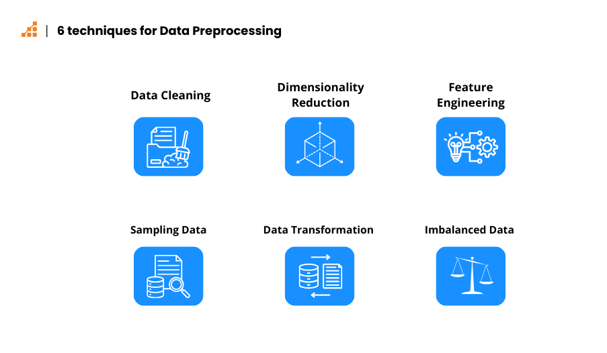



Data Preprocessing Steps
Remove Invalid Values
Eliminated temperature entries with ":" symbol
Data Type Conversion
Converted temperature column to float for analysis
Handle Missing Values
Applied median imputation for missing data points
Ensure Clean Dataset
Verified all data is numerical and analysis-ready

Slide 7


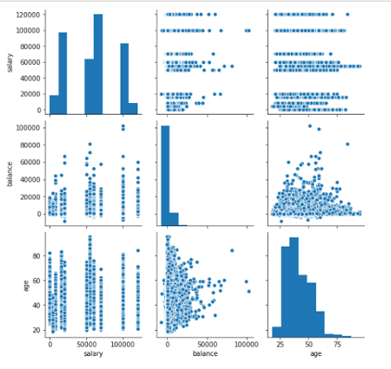


Exploratory Data Analysis - Key Findings
Two Clusters
Bi-modal Patterns
Data reveals two distinct groups suggesting different crop types or growing seasons
Rainfall & Temperature show two distinct peaks in distribution
Nutrient Impact
Key Predictor
NPK factors show partial influence on yield but are not dominant predictors
Temperature emerges as the strongest factor affecting crop yield
Temperature is the most critical factor for yield prediction

Slide 8

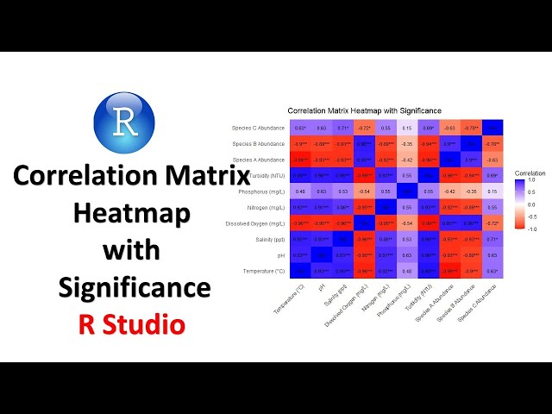


Correlation Heatmap Summary
Temperature & Rainfall
Moderate correlation with crop yield, showing significant influence
NPK Nutrients
Exhibit smaller influence on yield compared to climate factors
Non-linear Relationships
Dataset contains complex patterns requiring advanced modeling
Climate factors dominate nutrient effects on yield

Slide 9
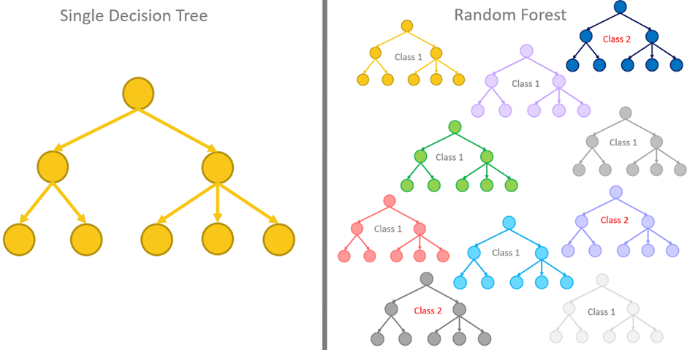



ML Models Used
Decision Tree Regressor
Single tree model with interpretable structure
Random Forest Regressor
Ensemble of multiple trees with higher accuracy
Tree-based models chosen for their ability to handle non-linear patterns and clustered data in the dataset

Slide 10
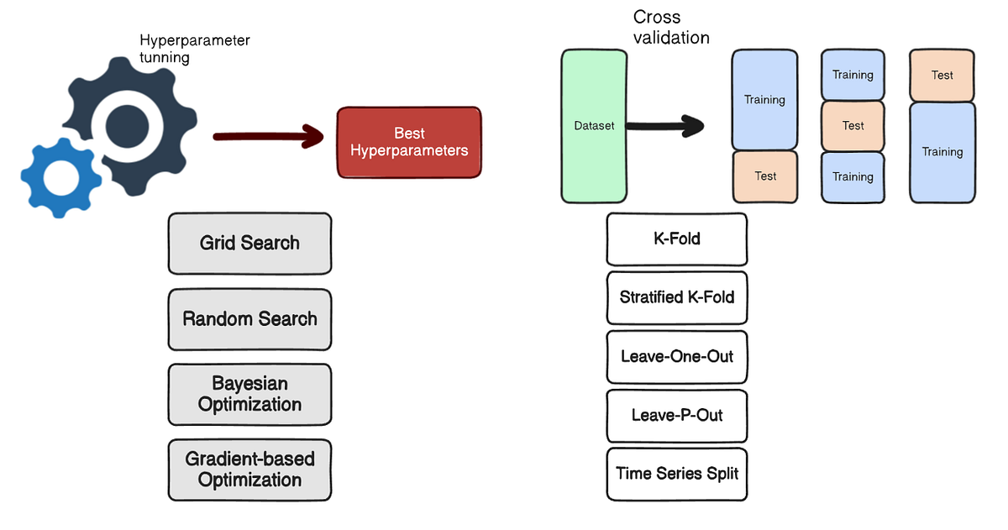







Hyperparameter Tuning (GridSearchCV)
Tuned Parameters
max_depth
min_samples_split
min_samples_leaf
n_estimators
random_state
GridSearchCV systematically works through multiple parameter combinations to find the optimal model configuration

Slide 11

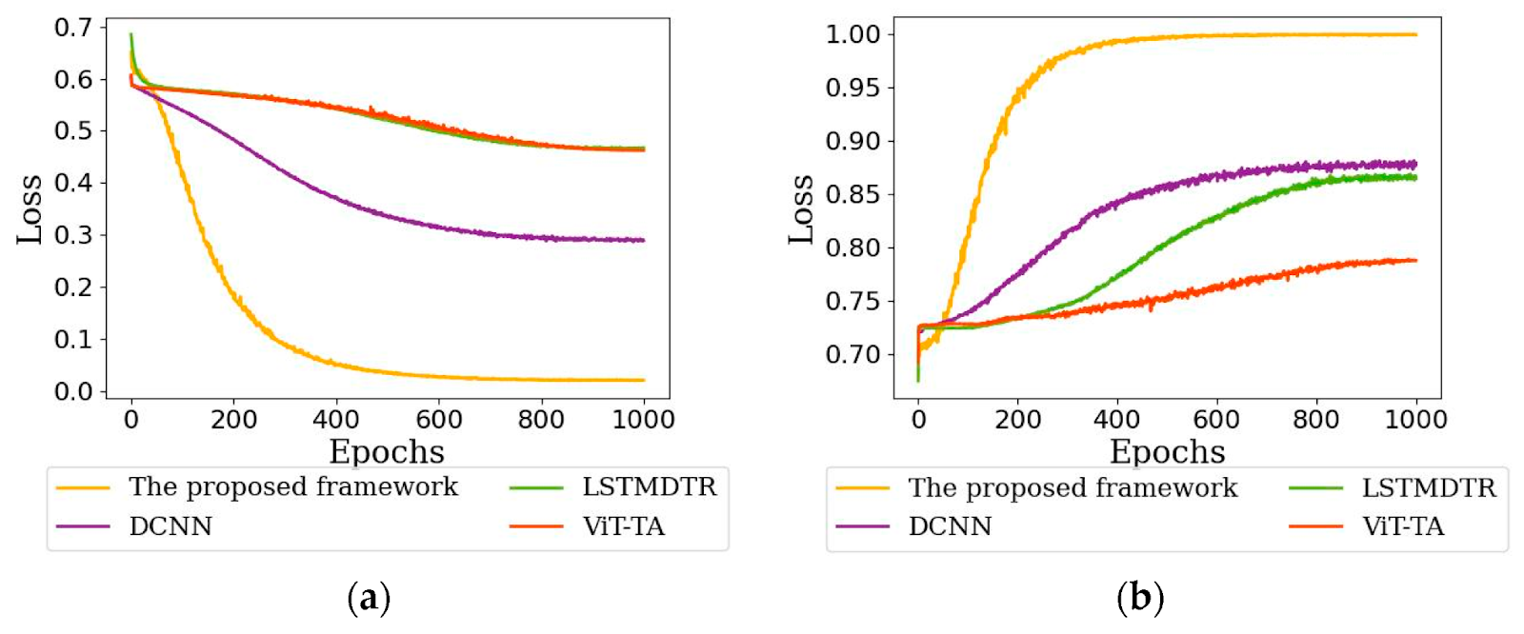



Model Performance Comparison
Decision Tree
R²
MAE
0.77
0.68
Random Forest
Better Model
R²
MAE
0.802
0.68
Random Forest shows higher R² value with same MAE, making it the superior model for yield prediction

Slide 12


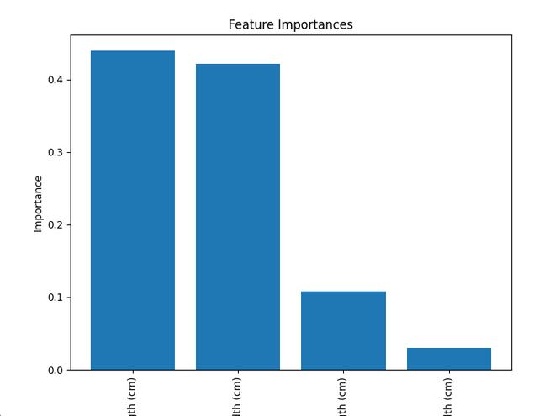




Feature Importance Insights
1
Temperature
Climate factors dominate nutrient effects in predicting crop yield
2
Rainfall
3
Fertilizer
4
Nitrogen (N)
5
Phosphorous (P)
6
Potassium (K)

Slide 13


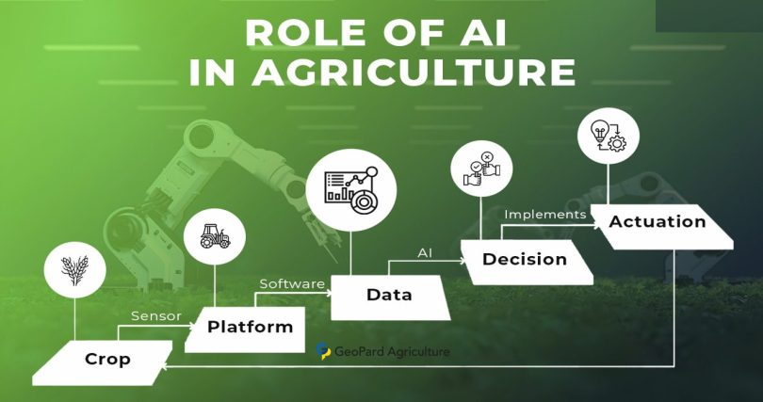
Conclusion
Two Crop Patterns
Machine learning enables precise yield prediction for smarter agricultural planning
Dataset reveals distinct clusters indicating different crop types or seasons
Temperature Dominance
Highest influence on yield among all environmental factors
Best Performing Model
Random Forest outperforms Decision Tree with higher R² value
Smart Agriculture
ML models can support data-driven decisions for improved farming

Slide 14






Limitations & Future Improvements
Missing Soil Data
Environmental Factors
Lack of comprehensive soil parameters affecting prediction accuracy
Missing humidity, sunlight, and soil pH measurements
Crop Identification
Advanced Models
Potential to add boosting models (XGBoost, CatBoost)
No crop type labels to differentiate between various crops
Build interactive web dashboard for farmers to access predictions

Slide 15





Acknowledgements
SURE Trust
For providing the platform and resources to pursue this project
Instructor: Bhargavesh Dakka
For invaluable guidance, mentorship, and technical expertise
Support & Guidance
To all who provided feedback and encouragement throughout this journey
Sincere gratitude for making this project possible

Slide 16




Thank You
For your attention and interest in our Crop Yield Prediction project
Project Repository
Scan to access the complete code, dataset, and documentation on GitHub
Pushkarjay Ajay
Pushkarjay.ajay1@gmail.com

